Slide 1
NANOCHEMISTRY
1 nm = 10⁻⁶ millimeter (mm) = 10⁻⁹ meter (m)
1 nm = 10 Angstrom

Slide 2
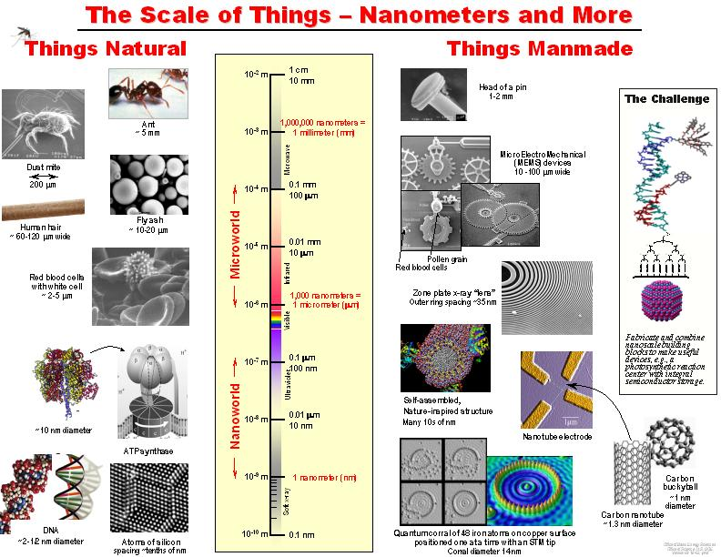
Scale of Things—Nanometers
Notes:
Scale of Things—Nanometers:
Hence, nanotechnology refers to the process, act or ability to work with materials or matter at the scale of 1 to 100 nanometers. The ability of working at this scale renders novel benefits to numerous products and applications such as those found in the semiconductor manufacturing, material science, medicine, etc.
However, what is the size of 1 nanometer? Albert Einstein estimated that the size of 1 sugar molecule was equal to 1 nanometer. One nanometer would also be equal to the linear size of 10 hydrogen atoms stacked side by side (Roueckes, et al., 2002). It is the same as one-billionth of a meter – a single bacterium is a few hundred nanometers in diameter and a DNA strand is approximately 2-12 nanometers across (NNI, 2007). The un-aided human eye can see down to about 10,000 nanometers (Ratner & Ratner, 2003).
A popular diagram found at www.nano.gov shows size comparisons of natural and manmade things relative to the nanometer.
Fig. 1.5 - http://www.nano.gov/html/facts/The_scale_of_things.html.

Slide 3
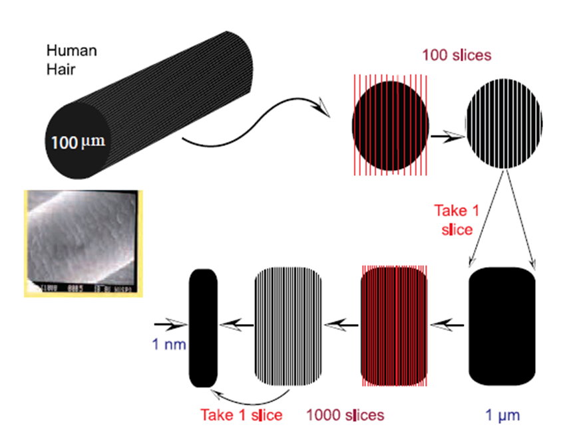
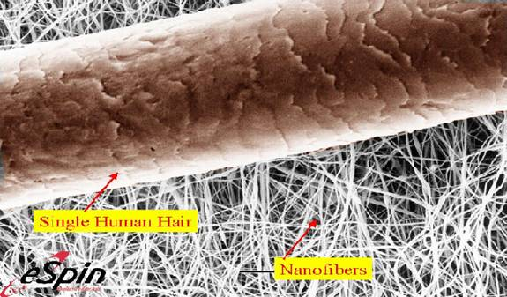
Nanoscience
A discipline concerning with making, manipulating and imaging materials having at least one spatial dimension in the size range 1–100 nm
Cross section of human hair

Slide 4


Nanotechnology
A device or machine, product or process based upon individual or multiple integrated nanoscale components
The decorative glaze known as luster. Ruby Red glass pot (entrapped with gold nanoparticles)
Nano-materials: Used by humans for 100 of years, the beautiful ruby red color of some glass is due to gold Nano particles trapped in the glass (ceramic) matrix.

Slide 5
Nanochemistry
Utilization of synthetic chemistry to make nanoscale building blocks of different:
Size and shape
Composition
Surface structure
Charge
Functionality.
Bulk. In bulk materials, only a relatively small percentage of atoms will be at or near a surface or interface (like a crystal grain boundary). | Nano. In nanomaterials, large no. of atomic features near the interface.

Slide 6
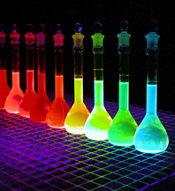
What’s the BIG deal about something so SMALL?
Materials behave differently at this size scale.
It’s not just about miniaturization.
At this scale---it’s all about INTERFACES
Size Matters!
Color depends on particle size
Quantum dots 3.2 nm in diameter have blue emission
Quantum dots 5 nm in diameter have red emission

Slide 7
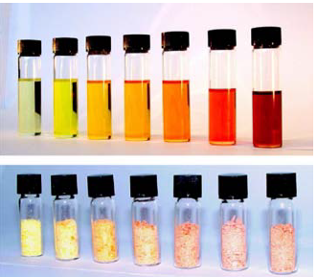
Effects of Nano size
Properties depends on size, composition and structure
Nano size increases the surface area
Change in surface energy (higher)
Change in the electronic properties
Change in optical band gap
Change in electrical conductivity
Higher and specific catalytic activity & chemical reactivity
Change thermal and mechanical stabilities
Different melting and phase transition temperatures
Various size of CdSe nanoparticles and their solution. The bulk CdSe is black

Slide 8
Properties of Nanomaterials
Surface area: Large.
Reactivity: High due to the unsaturated bonds.
Basic properties: Properties of materials change as: - their size approaches the nanoscale.
- percentage of atoms at the surface of a material becomes significant.
Example- Gold nanoparticles melt at much lower temperatures (~300 °C for 2.5 nm size) than the gold slabs (1064°C).
Optical properties: Often possess unexpected optical properties as they are small enough to confine their electrons and produce quantum effects. Example- Gold nanoparticles appear deep red to black in solution.

Slide 9
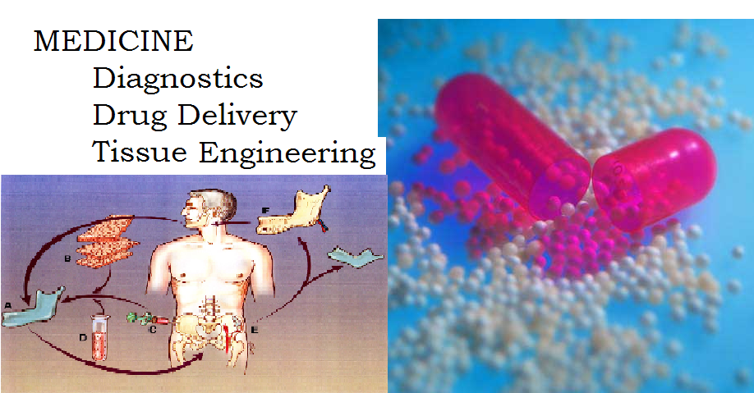

Applications of Nanomaterials
Environment
Catalysis
Filtration
Energy
Optics
Textiles
Cosmetics
Computers
Aerospace
Refineries
Vehicle manufacturing
Food packaging

Slide 10
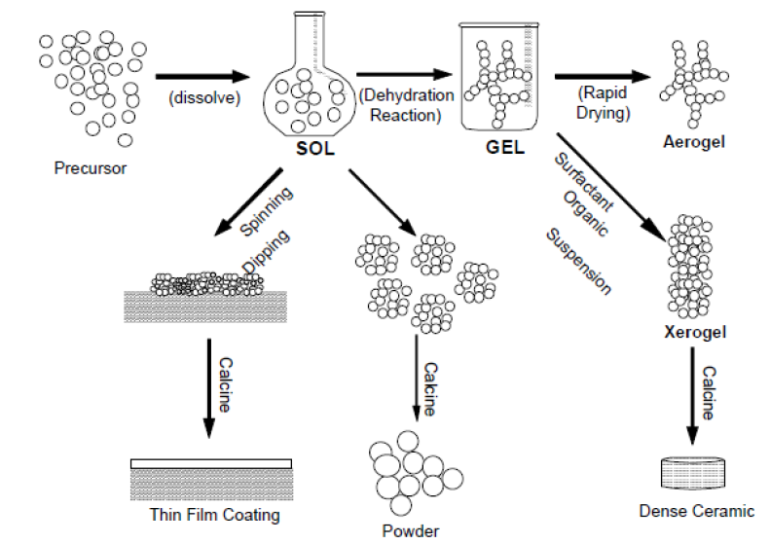
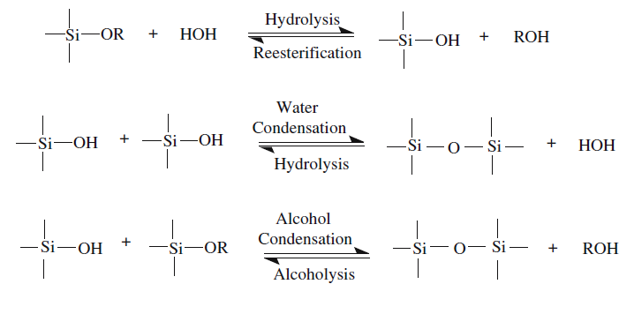
Sol-Gel Method:
Sol-gel processing refers to the hydrolysis and condensation of alkoxide-based precursors such as Si(OEt)₄ (tetraethyl orthosilicate, or TEOS).
Chemical method
Solution Phase
Bottom-Up approach
Classic sol-gel reaction scheme
Over all Steps:
Step 1: Formation of different stable solutions of the alkoxide (the sol).
Step 2: Gelation resulting from the formation of an oxide- bridged network (the gel) by polycondensation reaction
Step 3: Aging of the gel, during which the polycondensation reactions continue until the gel transforms into a solid mass.
Step 4: Drying of the gel, when water and other volatile liquids are removed from the gel network.
Step 5: Dehydration, during which surface- bound M-OH groups are removed, there by stabilizing the gel against rehydration. This is normally achieved by calcination at temperatures up to 800⁰C.
Step 6: Densification and decomposition of the gels at high temperatures (T>800⁰C). The pores of the gel network are collapsed, and remaining organic species are volatilized.

Slide 11
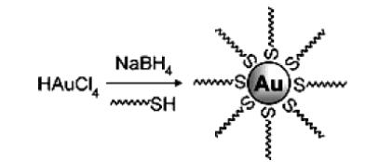
Wet chemical synthesis:
Chemical method
Solution Phase
Bottom-Up approach
Preparation of Gold nanoparticles
HAuCl₄ + Stabilizing agent + NaBH₄ Au nanoparticles
Stabilizing agents – Thiols, alkylammonium salts, surfactants etc
Stabilization with thiols involves two phase synthesis ( Thiols bind strongly with gold due to soft character of Au and S)
This method give smaller particle size and reduced dispersity
The concentration of Au/thiol ratio determines the particle size
The stability of particles depends on the chain length of thiols

Slide 12
Chemical precipitation:
Chemical method
Solution Phase
Bottom-Up approach
Reactant A
Reactant B
Mixing
Supersaturated solution
Fast chemical reaction is required to obtain a high degree of super-saturation of the product to favor homogeneous nucleation.
Nucleation
Primary processes
Nuclei
Crystal growth
Nanoparticles
Scheme of precipitation process.

Slide 13
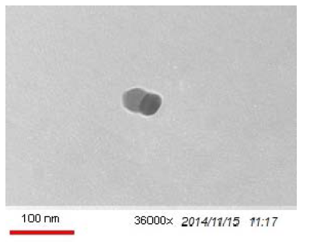
ZnO nanoparticles were synthesized by direct precipitation method using zinc nitrate and KOH as precursors. In this work, the aqueous solution (0.2 M) of zinc nitrate (Zn(NO3)2.6H2O) and the solution (0.4 M) of KOH were prepared with deionized water, respectively. The KOH solution was slowly added into zinc nitrate solution at room temperature under vigorous stirring, which resulted in the formation of a white suspension. The white product was centrifuged at 5000 rpm for 20 min and washed three times with distilled water, and washed with absolute alcohol at last. The obtained product was calcined at 500 °C in air atmosphere for 3 hr.

Slide 14
Hydrothermal synthesis (Thermal hydrolysis):
Chemical method
Solution Phase
Bottom-Up approach
Aqueous solutions of metal salts or gels are treated at elevated temperatures (100-300˚C) and pressures above 1 atm.
Size and shape of nanoparticles can be controlled by changing the conditions of the solutions:
pH
Concentration
Solvent and process conditions (temperature, duration, etc.).

Slide 15
Micro-emulsion synthesis (reverse micelles method):
Chemical method
Solution Phase
Bottom-Up approach
Microemulsions: Thermodynamically stable, optically clear dispersions of two immiscible liquids, such as water and oil.
They are formed, when a surfactant lowers the oil/water interfacial tension allowing thermal motions to spontaneously disperse the two immiscible phases.
Reverse micelles are molecular self assemblies from surfactants which have a spherical shape with a hydrophillic core and a hydrophobic tail on the sphere surface.
Most popular method to prepare nanosized inorganic particles as oxides.

Slide 16
Micro-emulsion synthesis (reverse micelles method):
If a surfactant possessing balanced hydrophilic and lipophilic properties is used in the right concentration, a different oil and water system will be produced. The system remains an emulsion, but exhibits some characteristics that are different from the milky emulsions discussed earlier. These new systems are “microemulsions”.
Water-in-oil microemulsions are also known as reverse micelles. These systems have the ability to solubilise both hydrophilic and hydrophobic substances

Slide 17
Ultrafine metal nanoparticles of diameter between 5 nm and 50 nm can be prepared by water-in-oil microemulsions. The nanodroplets of water are dispersed in the oil phase. The size of the droplets can be varied in the range of 5-50 nm by changing the water/surfactant ratio. The surfactant molecules provide the sites for particle nucleation and stabilize the growing particles. Therefore, the microemulsion acts as a microreactor.
The reactant metal salts and reducing agents are mostly soluble in water. Therefore, the nucleation of particles proceeds in the water pools of the microemulsion. One microemulsion contains the metal salt and the other microemulsion contains the reducing agent. The nanoparticles are synthesized by mixing the two microemulsions as shown in Fig
During the collision of the water droplets, interchange of the reactants (i.e., the metal salt and the reducing agent) takes place. The interchange of reactants is very fast so that it occurs during the mixing process itself. The nucleation and growth take place inside the droplets.

Slide 18
Interchange of nuclei or particles between the drops is hindered because it would require formation of a big hole during the collision of the droplets and would require a large change in the curvature of the surfactant layer around the drops, which is not favored energetically. Since the inorganic salts have very low solubility in the oil phase, the dynamic exchange of reactants between the droplets through the continuous phase is unfavorable. When the particles attain their final size, the surfactant molecules attach themselves to the surface of the particles and stabilize them. Further growth is also prevented by the adsorbed surfactant layer.
Percolation is a very important step in the particle nucleation. It is illustrated in the Fig. (b) for a bimolecular reaction: A + B C , where A represents the metallic salt (e.g., FeCl3), B represents the reducing agent (e.g., NaBH4), and C represents the metal particle.
For the reaction to occur, the reactant, A, located in the water pool of one droplet must find the reactant, B , located in the water pool of another droplet.

Slide 19
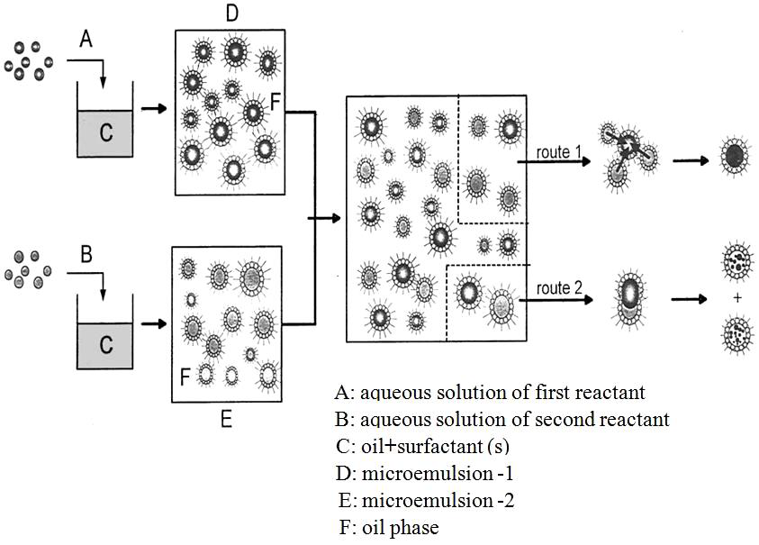
Figure-1

Slide 20
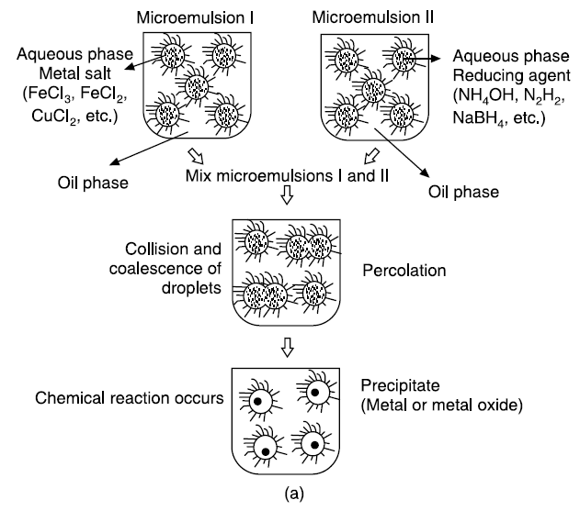
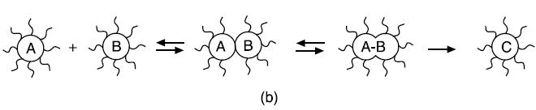
Figure-2
Follow any of the two Figure -1 or Figure-2 for describing the microemulsion method

Slide 21
Techniques to Characterize Nanomaterials
Scanning tunneling microscope (STM)
Atomic force microscope (AFM)
Scanning electron microscopy (SEM)
Transmission electron microscopy (TEM)
X-ray diffraction (XRD)

Slide 22
BRAGG’S EQUATION
X-ray Tube
Detector
Beam 2 lags beam 1 by XYZ = 2d sin θ
so 2d sin θ = nλ Bragg’s Law
Remember the ‘n’ may assume values 1, 2, 3... and so on for first, second and third order diffraction events respectively.

Slide 23
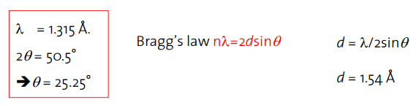
QUESTION:
The diffraction pattern of copper metal was measured with X-ray radiation of wavelength of 1.315 Å. The first order Bragg diffraction peak was found at an angle 2Ɵ of 50.5 °. Calculate the d-spacing between the diffracting planes in the copper metal.
HINT:

Slide 24
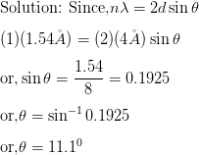
QUESTION:
Inter planar distance between two layers is 4Å in a crystal. Calculate the angle of reflection for first order reflection. X-rays of wavelength 1.54Å are diffracted by the crystal.
HINT:

